Slide 1
Travis Webb, LCSW
www.traviswebbtherapy.com
480-203-9653
Trauma
Family/Marriage
Addiction
Teens

Slide 2
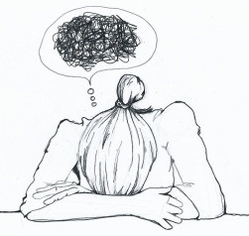
1. Lack of teamwork, empathy, and support between students
2. Working too many roles at the same time
3. No time to deal with bodily functions
4. Being made accountable for more than they should
5. Not enough time to plan
6. Excessive paperwork for data collection
7. Keeping up with the expectations of Admin, District, etc
8. Applying a prescribed curriculum to all types of students
9. Helping parents and students meet long-term goals
10. Student Apathy
11. Disrespect from Students
12. Lack of Parental Involvement
13. Cell Phones
14. Computers
15. Student Fatigue
16. Staff Fatigue

Slide 3
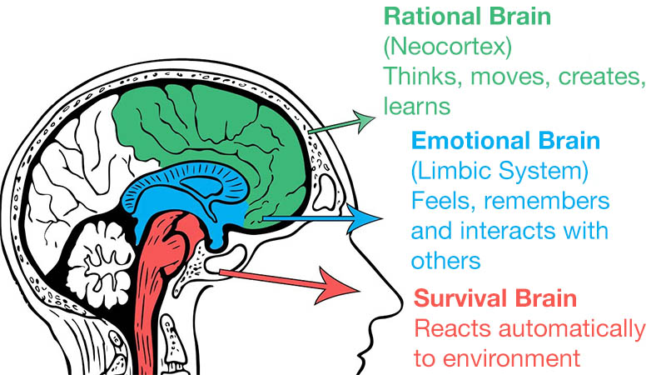

Slide 4

Who’s in charge?

Slide 5


Slide 6
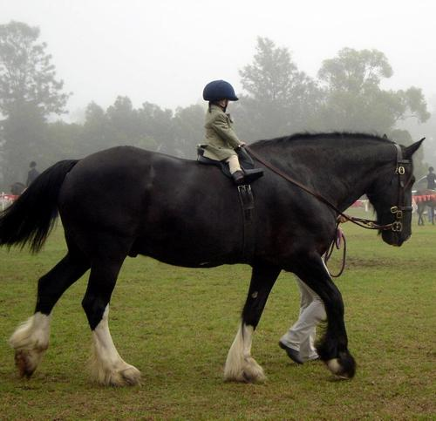
Teenage Brain

Slide 7

Tools to work with the Limbic System

Slide 8

FREEDOM
SAFETY
CONNECTION

Slide 9
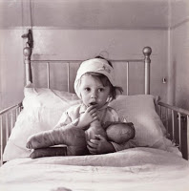
Endurance
Development
Growth
Emotional
Resilience
Physical Tension
Reach
Out
Attunement
Attachment
Bond
Secure Base
Vulnerability
(the birthplace of joy, belonging, creativity, love)
Speak needs
Tell your story..
Validation
A.R.E. you there?
EMPATHY
-Still face video
-It’s not about the nail
-Empathy v. Sympathy
E-motional Stress
Safety & Risk Increase
Physical Tension
Emotional
Isolation
Compensation
Behaviors
Compulsive
Patterns
emotional
frailty
Experiences self as alone.
Amygdale pulls the alarm.
Health Issues
Shame Develops
Worth is Challenged
Chemical escapes
(Alcohol, Porn, Drugs, Food, Sex, TV/Video games)
We Blame
We Perfect (control)
We Pretend

